Slide 1


Turntable MERG Arduino SIG
Part 1: Introduction
Meino de Graaf Mxxxx
Alan Lomax M8640
Notes:
MERG presentation for the Arduino SIG.
Prepared Jan / Feb 2023
Presented: (TBD)

Slide 2
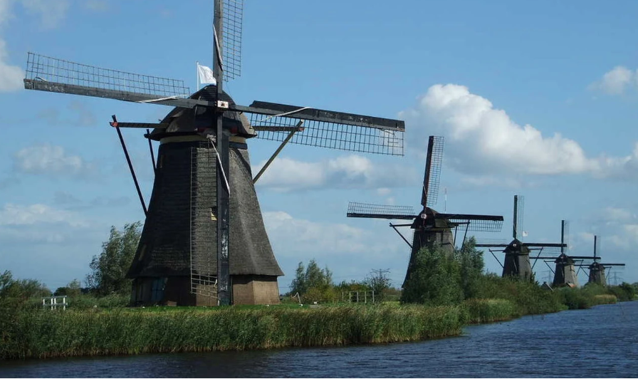

About Us
Meino de Graaf
calls Amersfoort, Holland his home
Alan Lomax
calls Ontario, Canada his home
Notes:
Introductions – a little bit about Alan!
Retired Electrical Engineer who worked in Petrochemicals – at first supporting maintenance and then doing Automation upgrade Projects
Technically – Networking plus Hardware and Software Integration. Focus was always control systems, safety shutdown systems and fault tolerant design.
Abnormal Situation Management – Ergonomic Factors
For the last few years I am back into model railways beginning with a rip and replace control system project!
Have been in MERG for less than two years, member of the Arduino SIG steering committee.
And.. I am not a professional programmer!

Slide 3
Agenda
Notes:
In this first part … develop the general concepts
How we met the challenges will be covered in our own individual presentations.

Slide 4
Details

Slide 5
Turntable – Block Diagram Here

Slide 6
Turntable – Expected Issues

Slide 7
Questions?
Part 6
Some Backup Material Follows
Back to Agenda

Slide 8
Backup Material

